Slide 1
Recession, Rates, and Real Estate
Presented By Mark Succarotte
Notes:
Batting Average, Information vs. Wisdom, Borrower Mindset

Slide 2
Today’s Learning Objectives
What is a recession and what can history teach us about recessions?
Is a recession likely in the next 12 months?
Will a recession mean mortgage interest rates will drop even further and by how much?
Will we see a decline in the housing market due to a recession?
Will the recession cause a foreclosure crises like we saw before?
How long will the recession last?
What does this mean for you?

Slide 3
What is a Recession?
A recession is a significant decline in economic activity spread across the economy, lasting more than a few months, normally visible in production, employment, real income, and other indicators. A recession begins when the economy reaches a peak of activity and ends when the economy reaches its trough. Between trough and peak, the economy is in an expansion.
These expansions (growth periods) and recessions are cyclical.

Slide 4
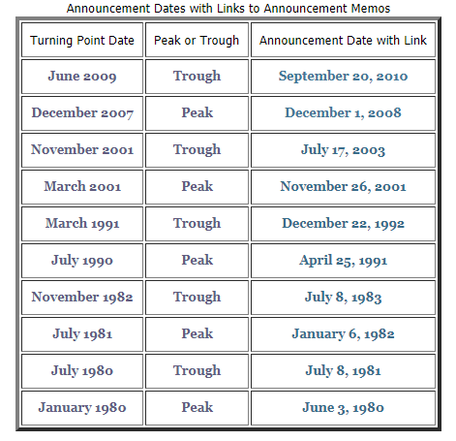
Who Determines A Recession?
Businesses, investors, and government officials track various economic indicators that can help predict or confirm the onset of recessions, but they're officially declared by the NBER, The National Bureau of Economic Research.

Slide 5
Past Recessions
13
THE GREAT DEPRESSION: (May 1937 - June 1938)
Duration: 13 months
GDP Decline: 3.4
Unemployment Rate: 19.1% (more than four million unemployed)
The Union Recession: (February 1945 - October 1945)
Duration: 9 months
GDP Decline: 11
Unemployment Rate: 1.9%
Post-War Recession: (November 1948 - October 1949)
Duration: 11 months
GDP Decline: 1.1
Unemployment Rate: 5.9%
Post-Korean War Recession: (July 1953 - May 1954)
Duration: 10 months
GDP decline: 2.2
Unemployment Rate: 2.9% (lowest rate since WWII)
The Eisenhower Recession: (August 1957 - April 1958)
Duration: 8 months
GDP Decline: 3.3%
Unemployment Rate: 6.2%
The "Rolling Adjustment" Recession: (April 1960 - February 1961)
Duration: 10 months
GDP Decline: 2.4
Unemployment Rate: 6.9%
The Nixon Recession: (December 1969 - November 1970)
Duration: 11 months
GDP Decline: 0.8
Unemployment Rate: 5.5%
The Oil Crisis Recession: (November 1973 - March 1975)
Duration: 16 months
GDP Decline: 3.6
Unemployment Rate: 8.8%
The Energy Crisis Recession: (January 1980 - July 1980)
Duration: 6 months
GDP decline: 1.1%
Unemployment Rate: 7.8%
The Iran/Energy Crisis Recession: (July 1981 - November 1982)
Duration: 16 months.
GDP decline: 3.6%
Unemployment Rate: 10.8%
The Gulf War Recession: (July 1990 - March 1991)
Duration: 8 months
GDP Decline: 1.5
Unemployment Rate: 6.8%
The 9/11 Recession: (March 2001 - November 2001)
Duration: 8 months
GDP Decline: 0.3
Unemployment Rate: 5.5%
Housing Bubble – Credit Crisis ( December 2007 – June 2009)
Duration: 18 months
GDP Decline: 4.3%
Unemployment Rate: 10.1%

Slide 6
Growth Periods

Slide 7
Are We Headed for a Recession?
While no one can exactly predict a recession, there are economic indicators that we watch such as:
Yield Curves
Confidence Indexes
Employment Data
Federal Reserve Bank of NY’s Recession Probability Model
Gross Domestic Product

Slide 8
Yield Curve – A Warning Signal
A yield is simply the interest rate on a bond, or Treasury. These Treasuries have differing lengths of duration, known as their maturity. Some bonds last one month; some last 30 years. The curve, therefore, compares how those interest rates change over time.
Typically, the interest is higher on a bond with a longer maturity – longer term means more risk and tied up capital. This means the yield curve is positive sloping most of the time.

Slide 9
Yield Curve Inversions
When the yield curve inverts, the curve becomes downward sloping. This inversion means investors are demanding a higher yield for Treasuries of shorter durations because they think it’s riskier to hold their bond over the shorter-term.
Traders, economists and strategists alike watch this curve because it has a particular track record for preceding downturns.
Inversions of the yield curve have preceded recessions for the past 50 years.

Slide 10
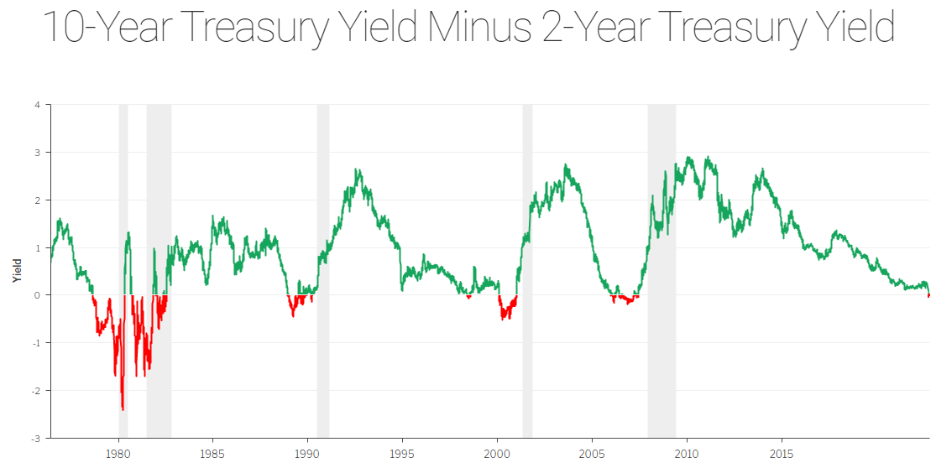
Notes:
dddd

Slide 11
Employment Data
Unemployment rate in August held at 3.7 percent, near the lowest level since 1969
Employers added 130,000 jobs in August, trailing the estimate among economists for a 150,000 gain -
But that’s still good news right?

Slide 12
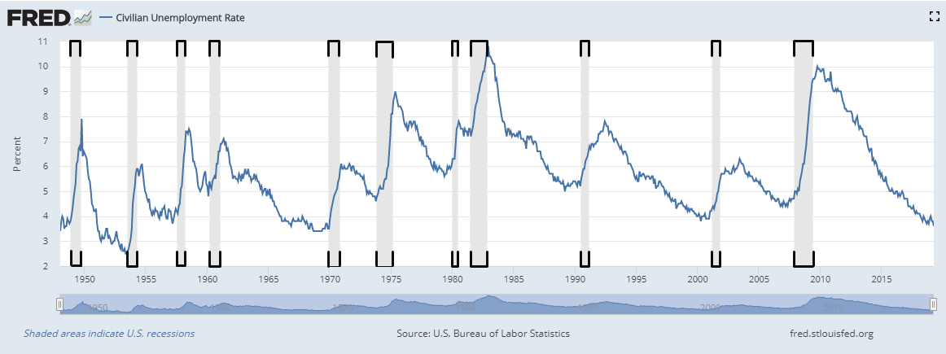
Unemployment and Recessions

Slide 13
The Recession Probability Model
The Federal Reserve Bank of New York’s Recession Probability Model is currently showing a 31.48 percent chance that a recession will occur in the next 12 months.
That’s the highest level since 2009.
A reading above 30% has preceded all recent recessions – yet they are still saying a recession is at least
12 months away.

Slide 14
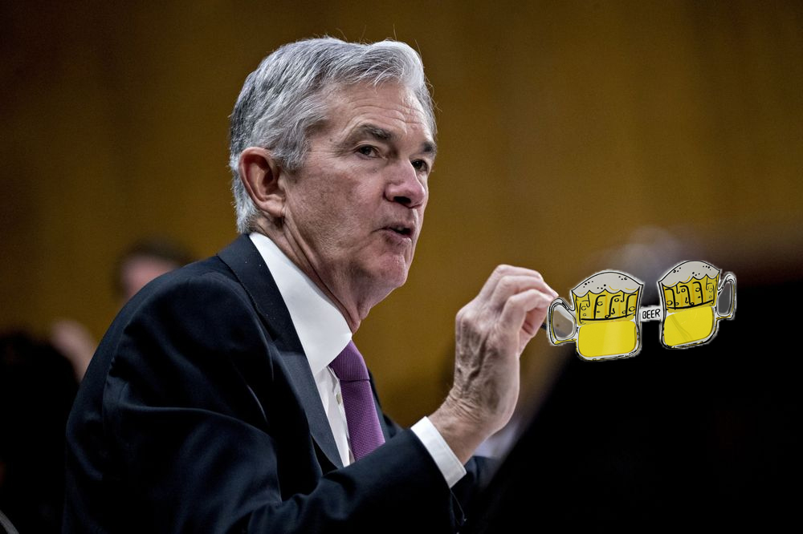
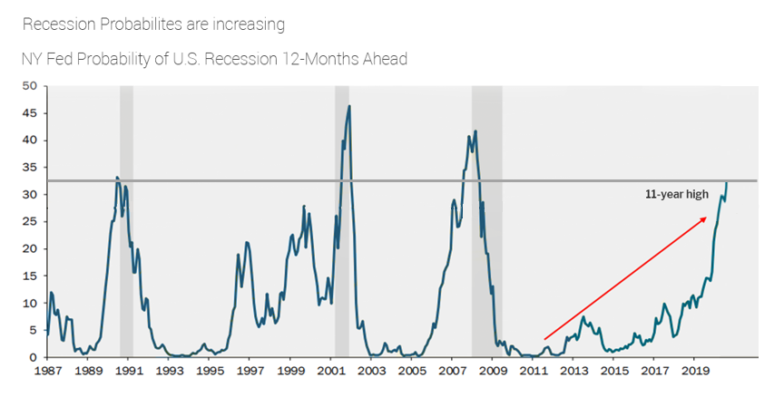
Fed Has Beer Goggles
33%
25%
15%
15%

Slide 15
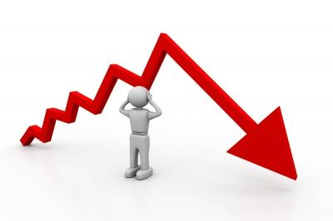
MORTGAGE INTEREST RATES
Will a recession mean mortgage interest rates will drop even further and by how much?

Slide 16
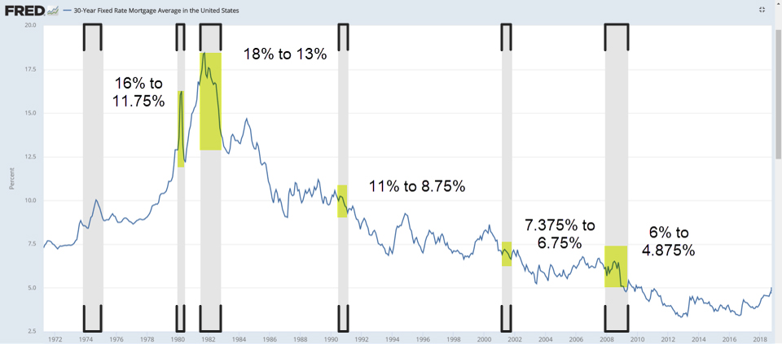
30-year Interest Rates Past 50 Years

Slide 18
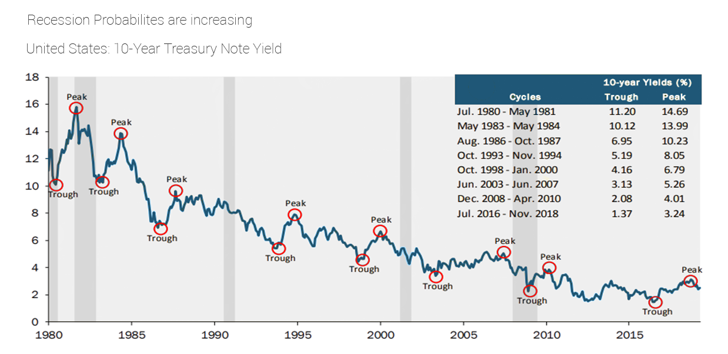
Lower Peaks and Lower Troughs

Slide 19
How Will This Affect Housing?
Consumer confidence – It Matters How People Feel
When people feel less confident about the future, they tend to spend less or avoid making major changes such as selling or purchasing new homes. This slows down the market.
Does this mean that home values will decline?

Slide 20
Are We in A Bubble?
One sign of a housing bubble is that home prices escalate.
The Case-Shiller National Index hit record highs in
December 2016.
In 2017, national median family home prices were 32% higher than inflation. Last time we saw this was 2005.
But it’s important to note, home prices only fell in
1 out of the last 4 recessions.

Slide 21
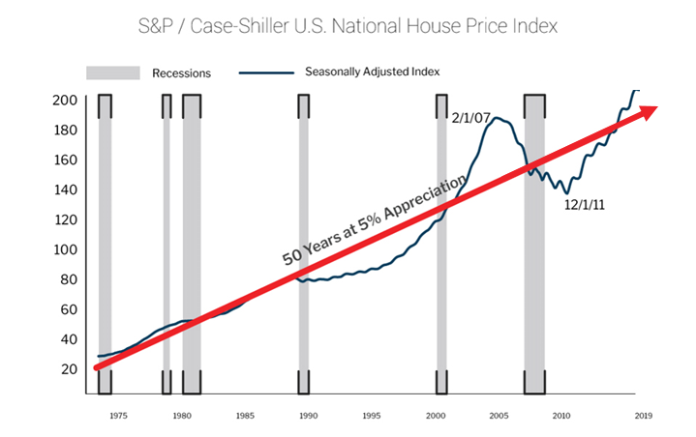

Slide 22
Will We See A Foreclosure Crisis Again?
NOT LIKELY
Banks Have Raised Lending Standards
Tightened guidelines
Required More Money Down
Today, the average FICO score for homebuyers is 686. In 2001, the average score was 490 to 510.

Slide 23
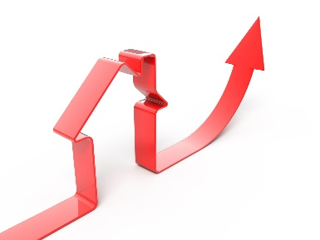
How Long Will It Last?
No one knows, but we can look to history. All other recessions since 1929 lasted a period of two years or less.
"This is going to be a much shorter recession than the last one," predicts George Ratiu, senior economist with realtor.com®. "I don't think the next recession will be a repeat of 2008. ... The housing market is in a better position.”

Slide 24
What Does This Mean For You?
Don’t Panic! Most analysts are predicting that this recession will be shorter – we may already be in it!
Recessions can be self-fulfilling. Too much pessimism stops activity – so be positive. Natural market correction is a good thing for affordability and sustainability.
If you aren’t already, START SAVING- so you can weather the storm when slow downs come.

Slide 25
What Am I Doing?
Educating myself so I can educate my buyers and sellers
Thinking about what markets will benefit during this recession and targeting them – investors, first-time homebuyers or buyers that lost their homes, have been renting and are poised to take advantage of low rates – be the go to source thru education?
Increase my marketing efforts - less competition in the market means my message goes farther
Take this opportunity to restructure debt and be ready to invest

Slide 26
The Bottom Line
Many recessions share the same characteristics - falling stock prices, lower interest rates, high unemployment rates, and a loss of consumer confidence, along with one other common trait:
They were all good times to buy real estate!!!!

